Slide 1
Health Innovation Dudley Project Update– Towns Board June 2022

Slide 2
Update on Bid
Appointment of Alliance Board
Post SSQ 8th June
Industry Day for procurement 24th June
SSQ Evaluation moderation 8th August
Notify tenderers 9th August
Presentation/interviews 5th Sept – 26th Sept
Behavourial Workshops 3rd Oct – 7th Oct
Assessment 24th Oct – 4th Nov
Approval to appoint 7th November
Award contract late November
Full Business Case
Submitted to DLUHC 19th April
First tranche of funding due this month
Waiting on any clarification questions

Slide 3
Project governance: pre-alliance Jan 2022 – Dec 2022
DMBC sign off, escalation and decision process
Key:
Political level
Partner meeting
Internal meeting
Towns Board
Quarterly
Chaired by Andrew Lovett
Cabinet
Strategic level
HID Steering group
Monthly
chaired by Helen Martin
Major capital board
Monthly
Chaired by Balvinder Heran
Project level
Towns Fund project team
Fortnightly
Chaired by Vicky Smith
Regen and Enterprise Strategy group
Fortnightly
Chaired by Helen Martin
Workstream level
IPI advisory team
Weekly
Key contact: Adam Westwood
Land Acquisition Group
Monthly
Key contact: Mary Cox
Demolition updates
Monthly
Key contact: Luke Davies
DMBC ad-hoc functions
Communications - Claire
Funding and monitoring - Jacki
Finance – Dave McNaney
Procurement – Peter Oakeshott (replacement tbc)

Slide 4
Proposed project governance: post- alliance Dec 22 onwards
DMBC sign off, escalation and decision process
Political level
Towns Board
Monthly
Charied by Andrew Lovett
Cabinet
Strategic level
HID Steering group
Bi- Monthly
chaired by Helen Martin
Major capital board
Monthly
Chaired by Balvinder Heran
Project level
IPI Alliance Board
Membership tbc
Towns Fund project team
Fortnightly
Chaired by Vicky Smith
Regen and Enterprise Strategy group
Fortnightly
Chaired by Helen Martin
Workstream level
Notes:
Alliance Board added which will include contractors and will operate as a ‘virtual business’ and sign off decisions within target cost.
TBC if DCoT will be a member of the alliance board
Integrated project team added which will have day-to-day responsibility for managing construction works
IPI Integrated Project Team (IPT)
Key contact : Adam Westwood
Land Acquisition Group
Monthly
Key contact: Mary Cox
Demolition updates
Monthly
Key contact: Luke Davies
DMBC ad-hoc functions
Communications - Claire
Funding and monitoring - Jacki
Finance – Dave McNaney
Procurement – Peter Oakeshott (replacement tbc)

Slide 5
Site update
Land Acquistion
Offers made to all land owners
K2 and Castle Hill Banqueting Suite appointing valuers to support process
Section 16 Notice to be issued next week
Preparing documents for a CPO if required go to September Cabinet in order to submit CPO in November
Demolition
Asbestos removal contractor appointed
Will have access 20th June to start surveys
Asbestos removal Sept – to late November
Demolition will start December 2022
Completion February 2023

Slide 6
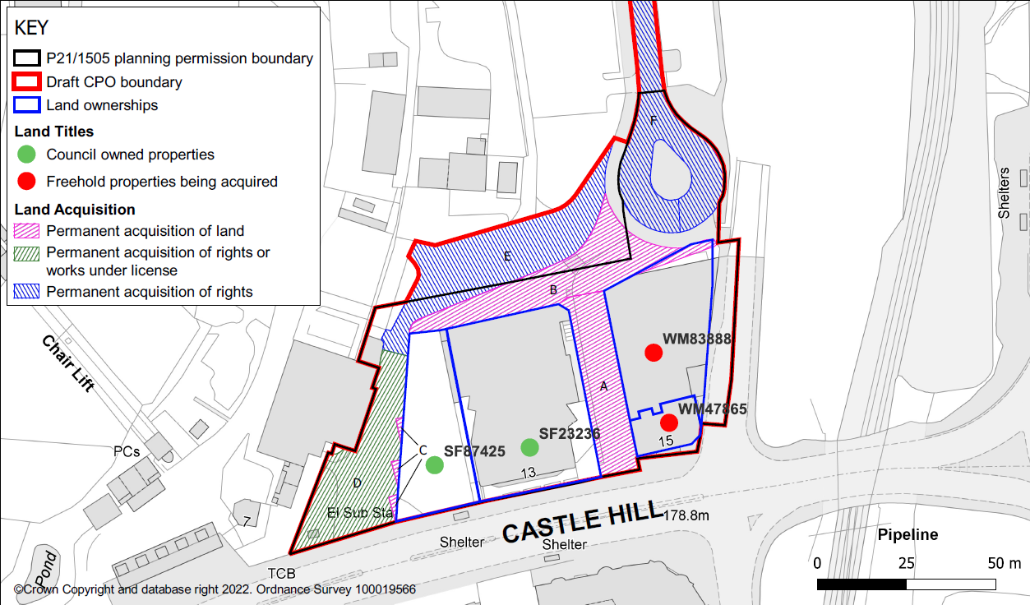
Land Acquisition

Slide 7
Risk No | Category | Title | Description and impact | Unmitigated Probability | Unmitigated Impact | Unmitigated Risk Rating | Mitigation/ Update | Mitigated Probability | Mitigated Impact | Mitigated Risk Rating | Owners | Risk score direction of travel | Status
Top 3 Risks – Worsening or no change
BR02 | Funding | Current project cost estimates show there is a need for additional gap funding to deliver 4332 story sqm building | Currently the project budget is esitmated to be around £27m, requirement to reduce project budget or secure gap funding from other sources | 4 | 3 | 12 | Reduce cost of project to fit within £25million budget involves building a smaller building by omitting level 4. Fixtures and fitting to be leased or privately funded. Meanwhile, alternative funding is being sought from WMCA and private donors | 4 | 3 | 12 | VS | No change | Open
BR05 | Site Acquisition | CPO of 15 Castle hill titles may delay programme | A CPO process for 13 or 15 Castle street may delay the programme until 2025 academic year | 5 | 4 | 20 | Communication still open with both parties, however, compensation expectations are unrealistic. Both parties now appointing external valuers. Formal CPO process has been commenced and order will be made in July cabinet. Detailed contingency project plan in place. | 5 | 3 | 15 | MCx | No change | Open
BR14 | Cost | Covid-19, Brexit and/or War in Ukraine worsens inflationary pressures and shortages | Further shortages may lead delay construction programme or delivery delays and increased costs due shortages and hyperinflation of building supplies | 4 | 4 | 16 | Material and labour issues may be resolved by the time project starts on site. If current shortages continue until construction phase, costs will increase by circa £1m. IPI delivery method will provide more certainty earlier on about project cost when alliance members have agreed outline solution | 4 | 4 | 16 | VS | Up | Open
Bottom three risks- improving
BR06 | Construction contract | IPI construction contract is new to local authorities and is relatively untested | IPI Intiatives were succesful in a procurement exercise to proide contract services and consultancy. However, costs were higher than expected and the applicability of the IPI model is in doubt | 4 | 4 | 16 | Continuing dialogue with procurement colleagues and SJ to advise. Legal advise from Trowers and Hamlins shows additional client risks are not substantial. Cabinet approval to use the IPI process has been secured | 3 | 3 | 9 | VS | Down | Open
BR07 | Demolition | Ability to discharge pre-demolition conditions within programme | Planning pre-deomlition condition 24 requires main contrustion contract to be let before demolition. This requires the allliance agreement to have been signed by all partners | 3 | 3 | 9 | LPA have agreed to discharge onsignature of the alliance contract. | 3 | 2 | 6 | VS | Down | Open
BR04 | Legal | Restrictive covenant on Hippodrome land may restrict land use | Covenant on Hippodrome sitewould restrict future uses if not mitigated | 3 | 3 | 9 | Legal opinion of Tim Mould QC received confirming the councils ability to override the covenant with section 203 of the HPA. Land appropraition for planning purposes and release of covenant will be achieved by July cabinet report | 2 | 3 | 6 | MW | Down | Open
RISKS

Slide 8
Programme
If no CPO required
Acquire site November 2022
Sign alliance agreement (construction contract) December 2022
Whole site cleared and remediated June 2023
Construction commences October 2023
HID Operational March 2025
If CPO required:
Alliance agreement signed December 2022
Hippodrome demolished February 2023
Full site acquired July 2023
Full site cleared and remediated (13 & 15 castle hill) November 2023
Construction commences December 2023
HID Operational May 2025

